Slide 1

Analytical CRM Development for a Bank
Ashish Kumar sah

Slide 2

Problem Statement
Our bank is facing challenges with customer churn, affecting overall profitability and customer satisfaction. The primary objectives of this analysis are:
Reduce Customer Churn: Identify factors contributing to customer exits and develop strategies to retain customers.
Improve Service Delivery: Enhance service quality by understanding customer needs and preferences.
Enhance Customer Satisfaction: Utilize insights from customer data to provide better, more personalized services.

Slide 3

Data Overview
The dataset includes customer information such as demographics, account details, and activity status. Key features include Credit Score, Tenure, Balance, Number of Products, Has Credit Card, Is Active Member, and Exited.
  Total Customers: 10,000
  Total Active Customers: 5151
  Total Exited Customer: 2037
  Churn Rate: 20.37%
  Total Balance: 764.86M
  Total Credit Card Holders: 7055
  Average Tenure: 4.86

Slide 4





Objective
Customer Behavior Analysis:
Risk Management Assessment:
Geographic Market Trends:
Customer Exit Reasons Exploration:
Churn Rate Analysis:

Slide 5

Methodology
Data Cleaning
Removed duplicates, handled missing values, and standardized data formats for consistency.
Data Enrichment
Enhanced dataset with calculated columns and measures.
Visualization & Reporting
Developed dashboards in Power BI to visualize key metrics and trends.
Used SQL queries to extract and visualize data efficiently.

Slide 6

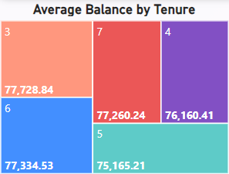
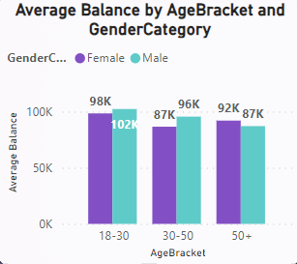
Customer Behavior Analysis
Findings
Tenure 3 years has the highest average balance: $77,728.84.
Female customers aged 18-30 have the highest average balance: $102K.
Younger customers (18-30) generally have higher average balances.
Analysis
Younger and female customers show higher average balances.
Long-term customers with specific tenures exhibit significant engagement

Slide 7

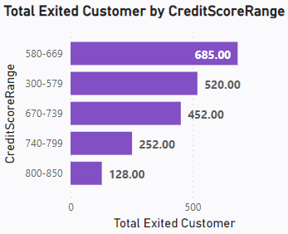
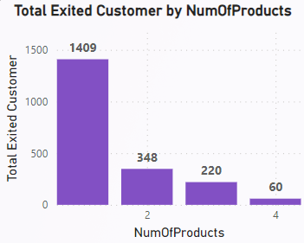
Risk Management Assessment
Findings
High churn rate observed among customers with low credit scores (580-669).
Customers with 1 product have a significantly higher exit rate compared to those with multiple products.
Analysis
Focus on improving credit score offerings and support to reduce churn among low credit score customers.
Encourage customers to diversify their product usage to improve retention.

Slide 8
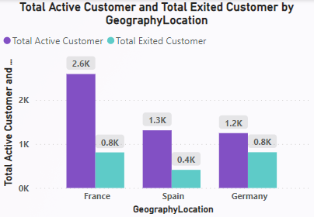

Geographic Market Trends:
Findings
France: Highest number of active customers (2.6K) and exited customers (0.8K).
Germany: Moderate number of active (1.2K) and exited customers (0.8K).
Spain: Lowest number of active (1.3K) and exited customers (0.4K).
Analysis
Market Focus: Retention strategies should target regions with higher churn rates, particularly France.
Tailored Strategies: Develop localized marketing and customer engagement strategies to address specific regional needs.
Regional Insights: Consider integrating regional economic data to better understand and address local factors influencing customer behavior.

Slide 9
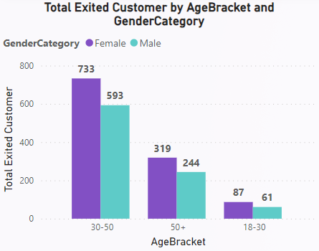
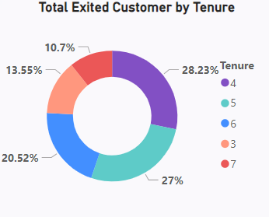
Customer Exit Reasons Exploration (Part 1)
Findings
Credit Score: Higher exits for scores 580-669.
Activity: Non-active members show higher exit rates.
Demographics: (30-50) age groups and females have higher exit rates.
Tenure: Highest exit rate within 1 year of tenure.
Recommendations
Enhance financial health programs.
Implement targeted retention for older customers and females.
Increase engagement for non-active members.
Improve early customer experience.

Slide 10
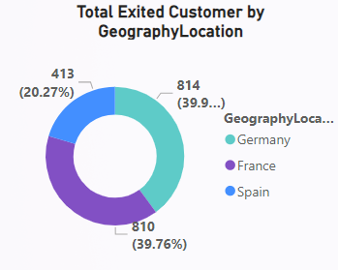
Customer Exit Reasons Exploration (Part 2)
Findings
Product Usage: Single product users are more likely to exit.
Geography: France and Germany have higher exit rates.
Balance: Higher balance customers tend to exit more.
Recommendations
Promote multi-product usage.
Develop region-specific strategies.
Provide financial advisory for high-balance customers.

Slide 11
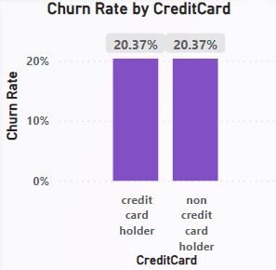
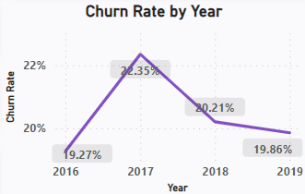
Churn Rate Analysis (Part 1)
Findings
Overall Churn Rate: 20.37%
Churn Rate by Year:
  2016: 19.27%
  2017: 22.35%
  2018: 20.21%
  2019: 19.86%
Churn Rate by Credit Card Holders:
  Credit Card Holders: 20.37%
  Non Credit Card Holders: 20.37%
Recommendations
Engagement Programs: Increase engagement with non-credit card holders and inactive members.
Regular Monitoring: Continuously monitor churn rates by year and demographic segments to adjust strategies accordingly.

Slide 12
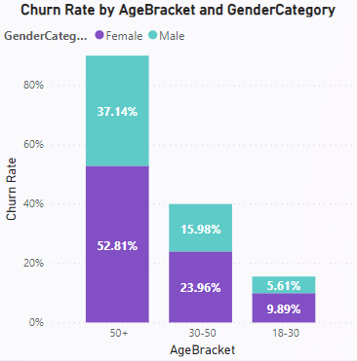
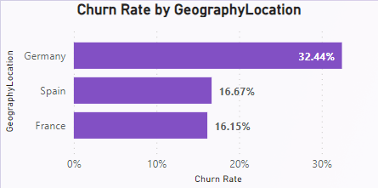
Churn Rate Analysis (Part 2)
Findings
Churn Rate by Age Bracket and Gender:
  Age 50+: Female 52.81%, Male 37.14%
  Age 30-50: Female 23.96%, Male 15.98%
  Age 18-30: Female 9.89%, Male 9.89%
Churn Rate by Geography:
  Germany: 32.44%
  Spain: 16.67%
  France: 16.15%
Recommendations
Targeted Retention Strategies: Focus on customers aged 50+ and females with tailored retention programs.
Geographic Focus: Develop specific retention strategies for high-churn regions like Germany.

Slide 13
Conclusion
Customer Churn Analysis: Customers with a single product show a higher churn rate compared to those with multiple products. Low credit score customers are more likely to leave the bank.
Product Affinity: Certain products, such as savings accounts and credit cards, are commonly used together. Understanding these affinities can enhance cross-selling strategies.
Credit Card Impact: Having a credit card slightly reduces the likelihood of customer churn.
Correlation Insights: There is no strong correlation between Estimated Salary and Balance, or between Estimated Salary and Credit Score, indicating other factors might be influencing customer retention.

Slide 14
Recommendations
Retention Strategies
  Target Single-Product Customers: Implement loyalty programs to encourage the use of multiple products.
  Improve Services for Low Credit Score Customers: Provide personalized financial advice and support to reduce churn.
Cross-Selling Strategies
  Leverage Product Affinity: Identify and promote commonly used products together.
  Personalized Offers: Use data analytics to create targeted, personalized offers.
Credit Card Programs
  Encourage Credit Card Usage: Highlight benefits and rewards to increase retention among credit card users.
Monitoring and Evaluation
  Regular Analysis: Continuously analyze customer data to identify trends and adjust strategies.
  Benchmarking: Regularly compare metrics to industry standards to ensure continuous improvement.

Slide 15
REPORTS

Slide 16
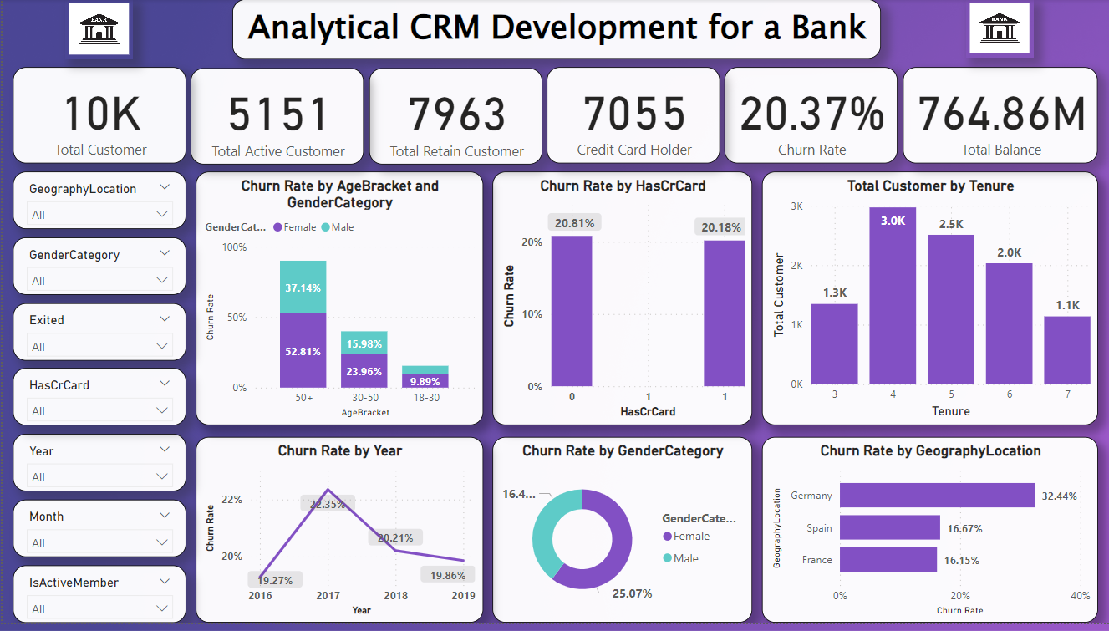

Slide 17
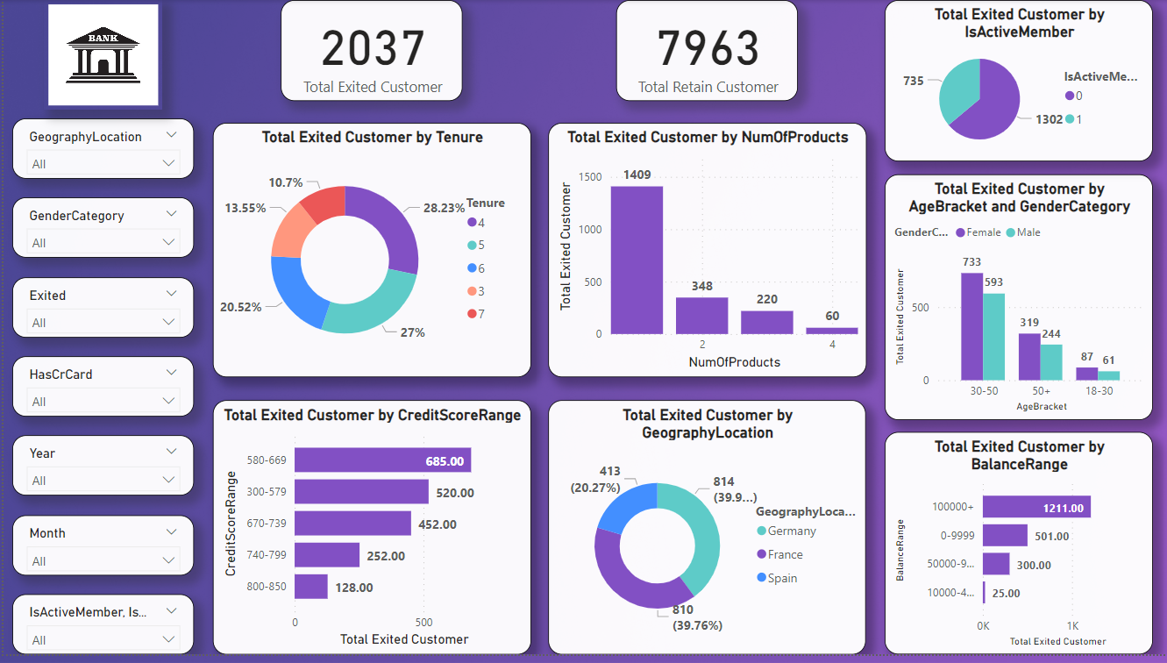

Slide 18
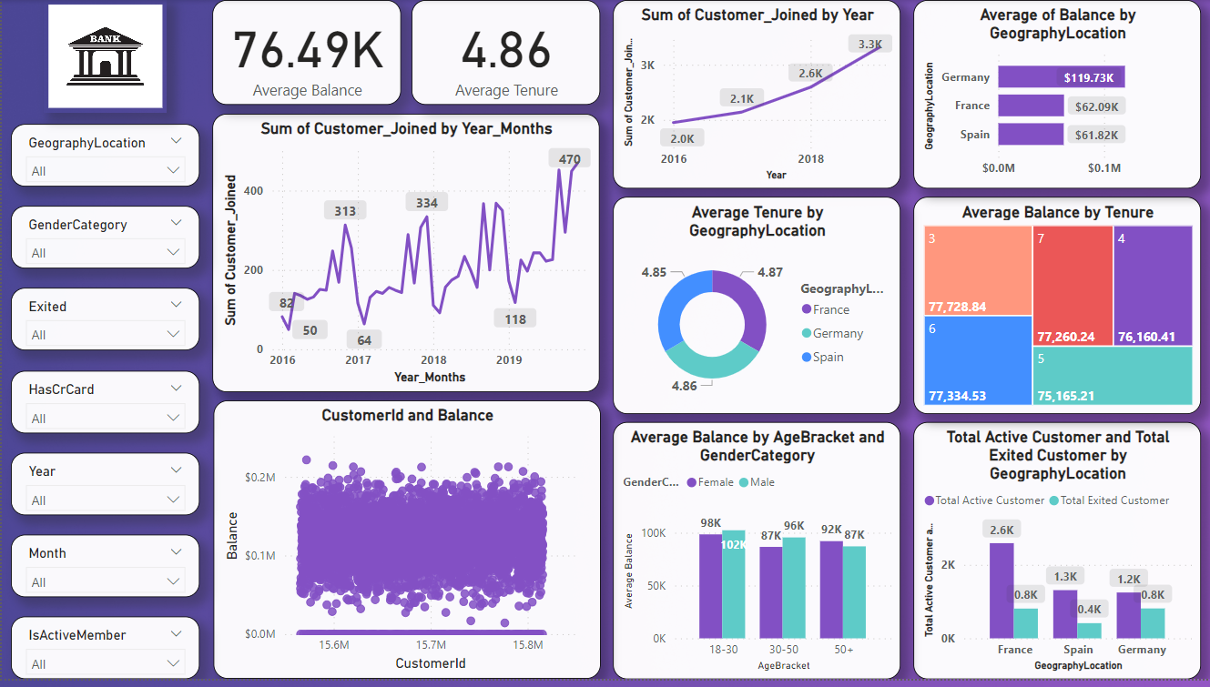

Slide 19
THANK YOU

